Slide 1
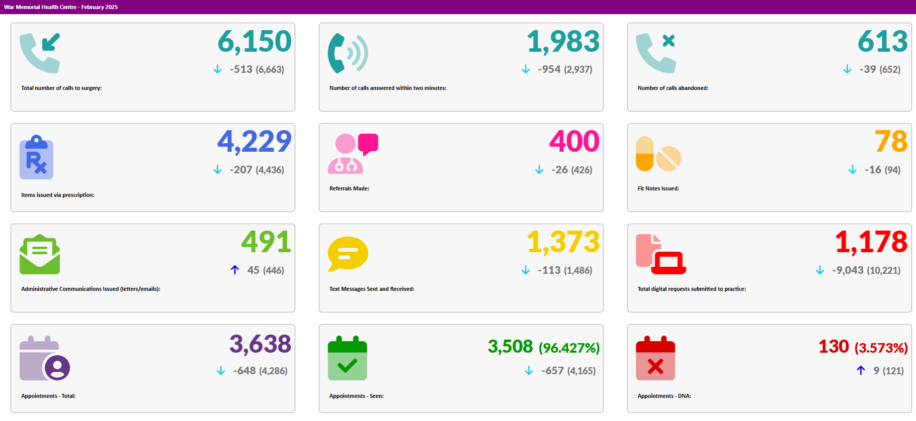
Crickhowell Group Practice Activity Data – February 2025

